Slide 1


ARISE MACHINE TOOLS SOLUTIONS

Slide 2
ARISE MACHINE TOOLS SOLUTIONS
SOLUTIONS FOR
SPECIAL TOOLS FOR CNC, VMC, HMC AND SPECIAL PURPOSE MACHINES (TURNING TOOL HOLDERS, ANTI VIBRATION BORING BAR, BORING TOOLS, MILLING CUTTERS, INSERTED U DRILL, INSERTED END MILL)
CARBIDE CUTTING TOOLS FOR MACHINING OPERATION (INSERTS, CARBIDE DRILLS, CARBIDE END MILL, CARBIDE BALL NOSE)
TOOL HOLDING SYSTEMS (ADAPTORS, COLLETS, SPARES FOR TOOL HOLDING SYSTEMS)
CRITICAL MACHINING PARTS
REPAIR AND RECONDITIONING OF LEAD SCREW, SLIDES AND BALL SCREWS.
SUPPLY OF INDUSTRIAL CUTTING OIL, ANTI RUST OIL, RUST PREVENTION OIL ETC.

Slide 3

OUR VISION AND MISSION
To be the world’s most reliable and innovative manufacturer, service and Solutions provider in the industry.
To supply high-quality products, providing related services and solutions to a worldwide client base while utilizing innovative technologies within an environment of motivated employees, focused on continuous improvement, highest business standards, work ethics and corporate citizenship, leading to added value for our customers.

Slide 4

Team Spirit
Within the ARISE MACHINE TOOLS SOLUTIONS, we act together as one team.
Our team vision also includes close co-Operation and relationships with customers.
Experience Man Force of Technical, Electrical, and Operations acting as ONE TEAM.

Slide 5

quality POLICY
The company led by Mr.NASIRHUSEN MAHABARI is dedicated to provide quality solutions to all of its customers. This has been achieved through knowledgeable employees who believe that integrity matters, hard work, and excellent service.
ARISE MACHINE TOOLS SOLUTIONS and its team of dedicated professional staff are committed to provide exceptional service which includes excellence in every aspect.
We believe in Quality bringing steel close to the every need of Customers and development growth at industrial.

Slide 6

Safety Policy
We are committed to provide Safe and healthy working environment to all employees and our customers as an integral part of business
Our Motto at our site is Safety, Quality and Progress.
We will ensure safety and health of our employees by creating awareness among them.
We will provide them with necessary training to achieve our safety goals.
We will minimize accident by eliminating all unsafe acts and unsafe conditions.
We will minimize risk of person and material by adopting safe methods.
We will comply with all safety rules and regulations.
We will minimize air, water, and noise pollution by using environment friendly equipment’s.
We will give top priority to safety, quality during production and execution

Slide 7
Contact us
Work-
GAT NO 1403, LATE SHREE KASHINATH INDUSTRIAL ESTATE, SHOP NO 02/03
CHIKHALI-SONWANE WASTI ROAD,,
TALAWADE
PUNE - 411062
MAHARASHTRA,
INDIA
Office –
E 605, SAI EXOTIQUE, GAT NO 1660/1,
BAG VASTI, PATIL NAGAR,
CHIKHALI, PUNE - 411062
MAHARASHTRA,
INDIA
Contact Person –
Mr. NASIRHUSEN MAHABARI
+91 9130472008
arise.tools@gmail.com

Slide 8
OUR COMPANY DETAILS
Company Name - Arise Machine Tools Solutions
GST NO - 27AAZFA3603Q1ZR
PAN No - AAZFA3603Q
Bank Account Name - Arise Machine Tools Solutions
Bank Account Type - Current
Bank Name - Samarth Sahakari Bank Ltd, Solapur
Branch Name - Thermax Chowk, Chinchwad, Pune
Acc No - 0070051010000360
MICR CODE - 411176253
IFSC Code - SBLS0000001

Slide 9
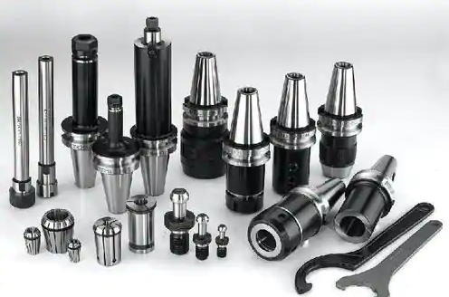
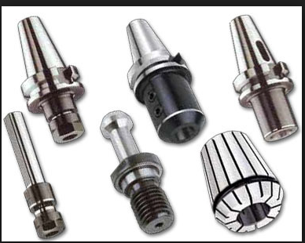
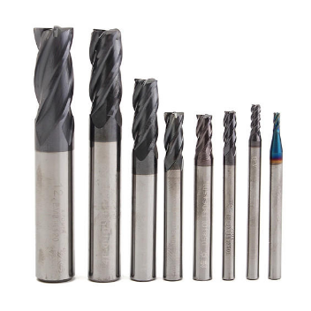
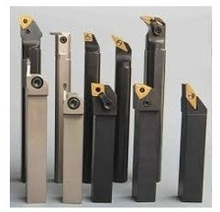
PRODUCT RANGE

Slide 10
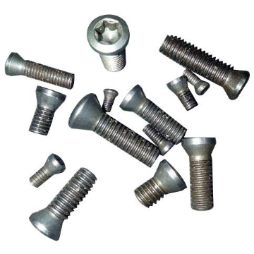
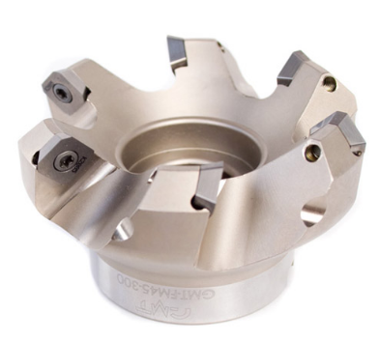
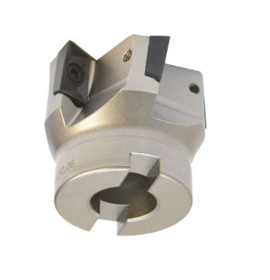
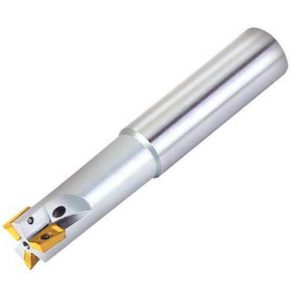
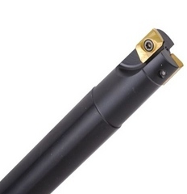
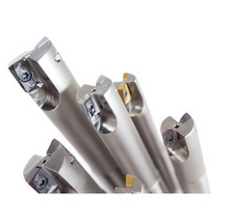
PRODUCT RANGE

Slide 11
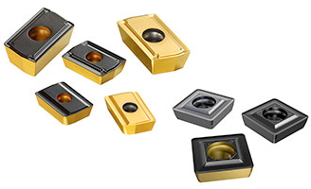
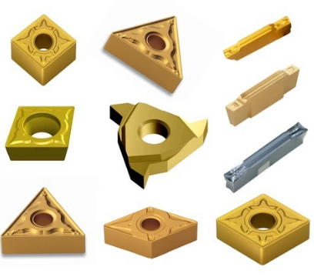
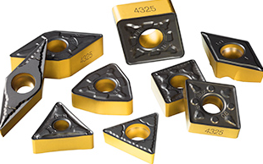
PRODUCT RANGE

Slide 12
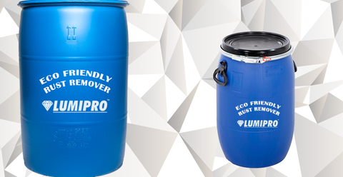
PRODUCT RANGE
LUMIPRO ECO FRIENDLY RUST REMOVER
LUMICLEAN OIL AND GREASE CLEANER
PAINT STRIPPER
MULTI USE SPRAY
RUST PREVENTIVE OIL
RUBBER LUBRICANT
CUTTING OIL
ANTI SPATTER GEL
ANTI SPATTER PEST
ELECTRONIC COMPONENT CLEANER
DE FOAMING AGENT
HEAT EXCHANGER CLEANER
WATER SOLUBLE CLEANING MEDIA

Slide 13
THANK YOU

